Slide 1

BackupIQ Acquisition Proof Kit
Douglas Mitchell
September2025

Slide 2

CONTENTS
01
Product Proof
02
Market & Growth
03
Legal & IP
04
Extras & Next Steps

Slide 3


01
Product Proof

Slide 4
Architecture Overview
A unified, secure, and scalable system for intelligent data protection.
Source Systems
BackupIQ Engine
Cloud Storage
Observability
Databases, File Systems
Docker, K8s, Health Checks
AWS S3, Object Stores
Prometheus, Logging

Slide 5

Deployment in 5 Steps
1
3
5
2
4
Clone & Configure
Health Check
Deploy to K8s
Set up env variables.
Docker Compose Up
curl /health endpoint.
Access Metrics
Apply manifests.
Start services.
Visit /metrics.
$ docker compose up -d
$ curl -sf http://localhost:8000/health
{"status": "ok"}

Slide 6
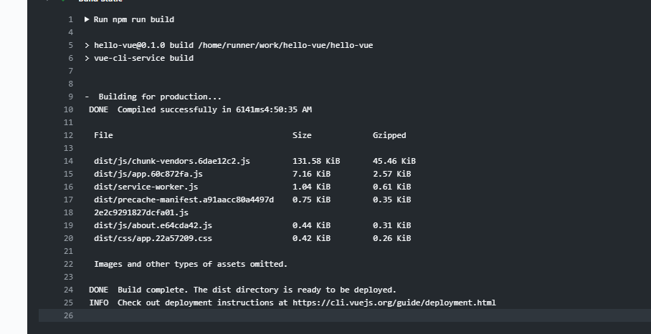
CI & Test Evidence
Continuous validation ensures reliability and security.
GitHub Actions Workflow
Unit & Integration Tests
100% Pass Rate
Security Linting
Zero Vulnerabilities
Automated testing, linting, and security scanning on every push.

Slide 7
Live Demo Snapshot
A 2-minute Loom walkthrough verifying every critical function.
1. Spin Up & Backup
2. Restore
3. Metrics
Container starts cleanly, backup job executes successfully.

Slide 8
02
Market & Growth

Slide 9

Problem Worth Solving
A critical gap exists between data risk and viable solutions.
Enterprise Fear
Crippling anxiety over data loss, downtime, and compliance failure.
Builder's Burden
A daunting 6-12 month DIY timeline with a $75K-$100K development cost.

Slide 10

The Solution: BackupIQ
A turnkey intelligent backup platform, deployable in 48 hours.
Dockerized & Modular: Non-root, multi-stage builds for security.
Kubernetes Ready: Manifests with probes for orchestration.
Observability Built-in: Prometheus metrics and structured logging.
Multi-Cloud Storage: Flexible support for AWS S3 and more.

Slide 11
Value Proposition & Buyer Fit
Cost & Time Savings
Versatility
Production-Ready
Save $75K-$100K and 6-12 months in development.
Adaptable for SaaS, Shopify, MSPs, and Web3 applications.
Not a template. A complete, tested, enterprise-grade system.
Ideal Acquirers
MSPs seeking client services, SaaS founders needing instant credibility, and Ecommerce/Web3 teams requiring specialized restore workflows.

Slide 12
Competitive Edge
Feature
BackupIQ
Veeam
Acronis
Datto
Rewind
Speed to Deploy
48 Hours
Weeks
Weeks
Weeks
Days
Total Cost
$10K-$15K
$$$ (Subscription)
$$$ (Subscription)
$$$ (Hardware + Sub)
$$ (Subscription)
Adaptability
Full Code Access
Closed
Closed
Closed
Closed
Key Differentiator: BackupIQ offers source-code ownership, not just a subscription.

Slide 13
POPULAR
"Better" License
"Best" License
$9,999
$14,999
Perpetual Usage Rights
Everything in "Better"
Full Codebase Access
6 Hours Advisory
Standard Documentation
90 Days Support
Scarcity: Only 5 licenses per quarter. High margin, non-exclusive, recurring revenue potential.

Slide 14
Go-to-Market Playbook
Digital Advertising
Run targeted LinkedIn and Google ads to reach SaaS founders and MSPs.
SEO & Content
Target keywords like "backup SaaS" and "Shopify backup". Publish technical blogs and Loom demos to attract organic traffic.
Social Proof
Engage on IndieHackers, LinkedIn, and X.

Slide 15
03
Legal & IP

Slide 16

License Scope
A non-exclusive, perpetual, and risk-free license agreement.
Usage Rights: Use, modify, and commercialize the codebase.
Entity-Based: Valid for one company and its internal use.
Restrictions: Resale or redistribution of the raw software is prohibited.

Slide 17
IP Ownership Assurance
A formal guarantee of clean title, eliminating future litigation or compliance risks.
Original Authorship
No Encumbrances
Clean Title
All code, trademarks, and algorithms are originally authored or properly licensed.
Free from third-party claims, copyleft restrictions, and IP conflicts.
You gain clear ownership, ensuring a secure and compliant acquisition.

Slide 18
04
Extras & Next Steps

Slide 19
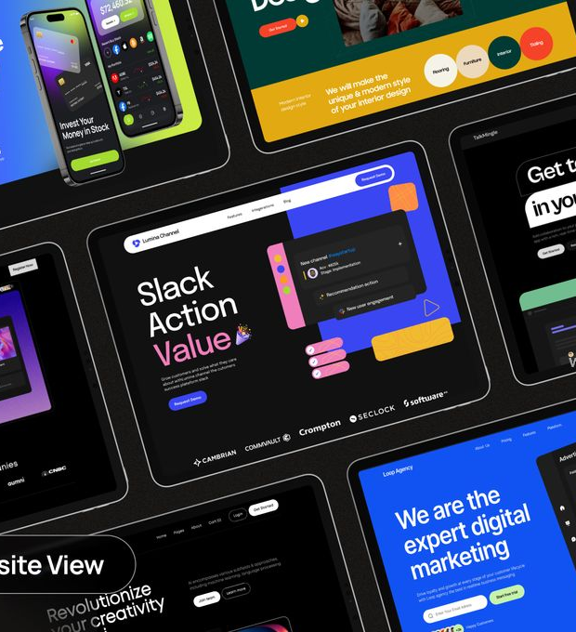
Demo Website Preview
A professional, ready-to-launch marketing site is included.
Built with React & PixelBlast for a modern look.
Features clear pricing tiers and a value calculator.
Allows you to establish brand presence instantly.

Slide 20
One-Pager Brochure
A portable leave-behind to reinforce key selling points.
BackupIQ
The Turnkey Backup Platform

Slide 21
Upload Checklist for Acquire.com
PDF Documents
Pitch Deck, Growth Playbook, Competitor Table, License Agreement.
Video Assets
Loom Demo Link (MP4).
Supporting Docs
Deployment Guide, Test Report.
A complete, professional listing that accelerates buyer due diligence.

Slide 22

THANK YOU
Douglas Mitchell
September 2025

